Slide 1


Project Eir
Team Pantheon

Slide 2
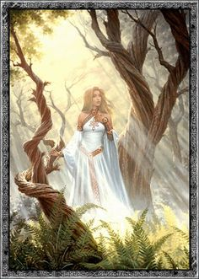

Graphic User Interface: Theme
Eir: Norse goddess of healing
Overall Theme: Selesnya, Nature, Healing
Color pallet: Peach/Tan, Green, and white

Slide 3
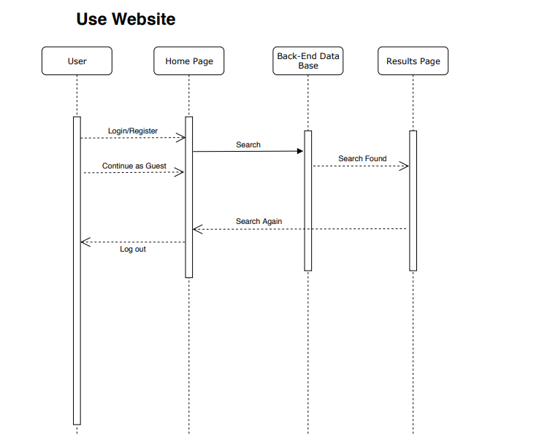
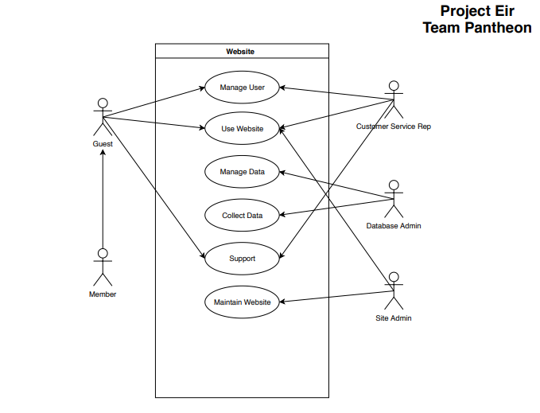
Graphic User Interface: Basic Structure
Main 5 actors
Easy and efficient flow in the website
Common theme throughout the website
Based the website off diagrams

Slide 4
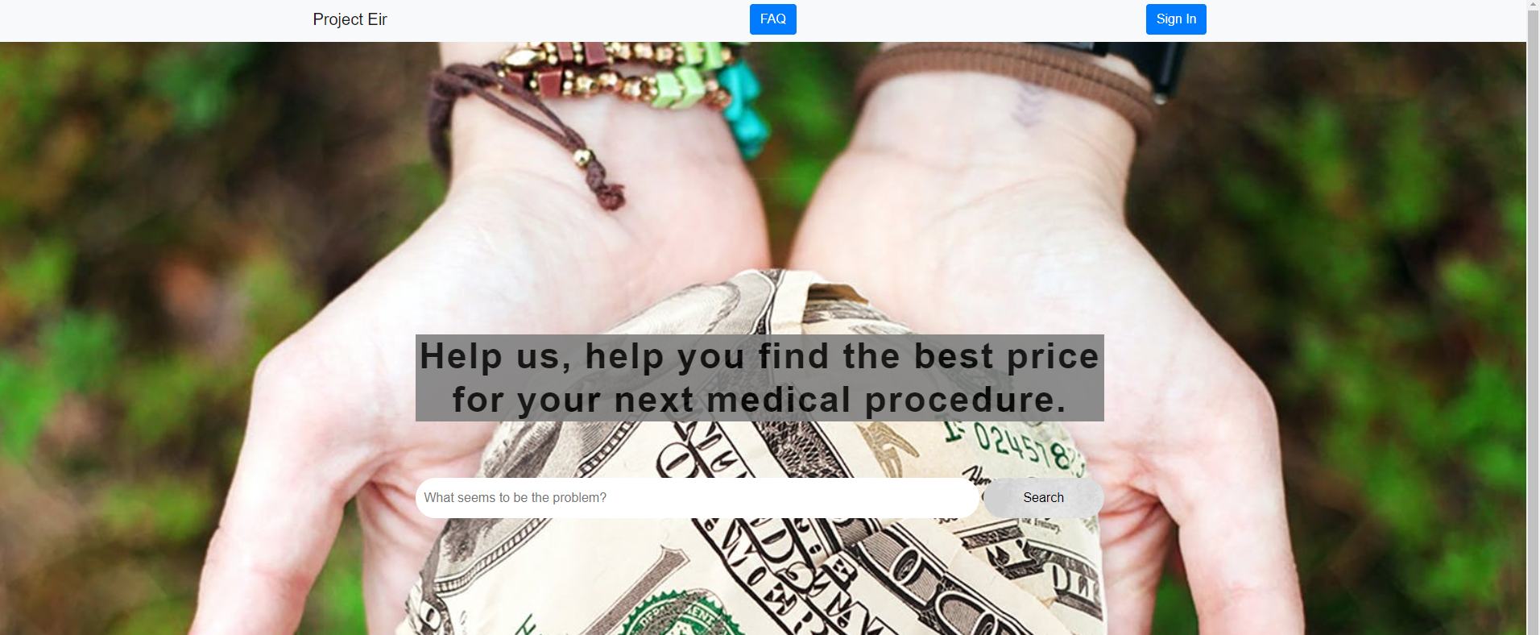
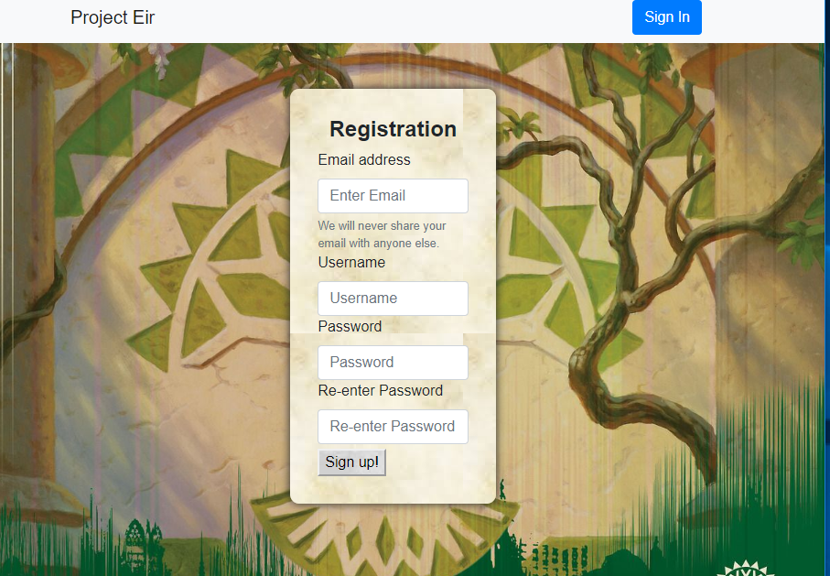
Graphic User Interface: Dependencies
The front ends link
Tags and IDs
Styling choices

Slide 5
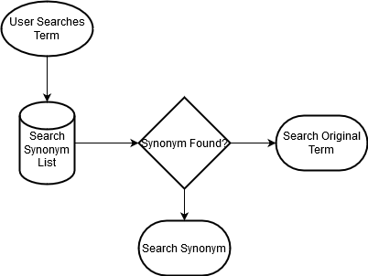
Synonym System
Allows for easier searching
Consolidates various procedure names into more searchable term.
Ex. Allowing carcinoma to show up when cancer is searched.
No noticeable slowdown when searching.
No
Yes

Slide 6
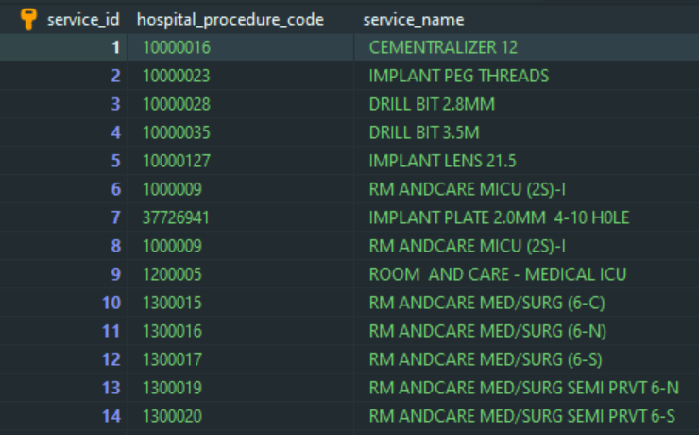
Searching
After searching for a synonym the search system queries the database
Database for procedures
Seperate Database for hospital info
Searches are fast and reliable
Searches are not case sensitive

Slide 7
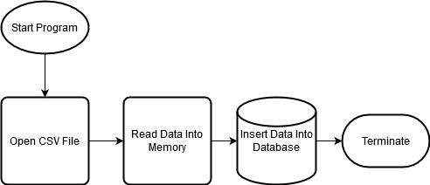
Data Insertion
Automatically enters data into database.
Fast and Efficient
Each hospital has a unique ID
One table for all procedures hospitals offer in a county
Easy to update

Slide 8
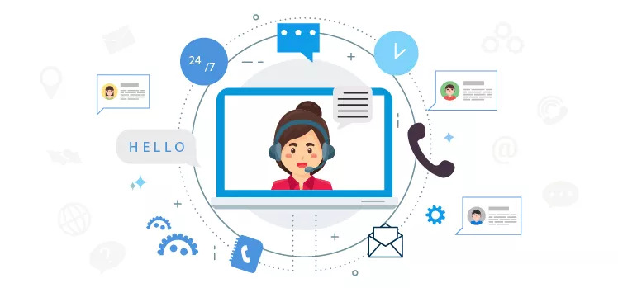
Customer Support
Customer Support should be simple for users to find and use
Once a user get to the support page it should be easy to understand.
Customer Support should have a few different types of support
Live Chat
FAQ
Support Tickets
Project Eir has two different types of support that it supports

Slide 9
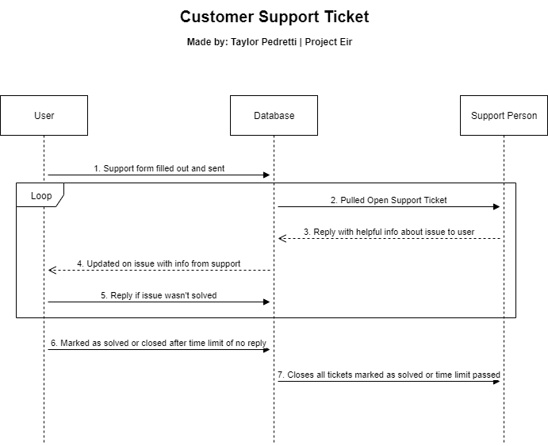
Customer Support - Sequence Diagram
Sequence Diagram of a support ticket
The process should be simple to understand and streamlined
Three basic actors
User
Database
Support Personal
All conversation gets saved to the database

Slide 10
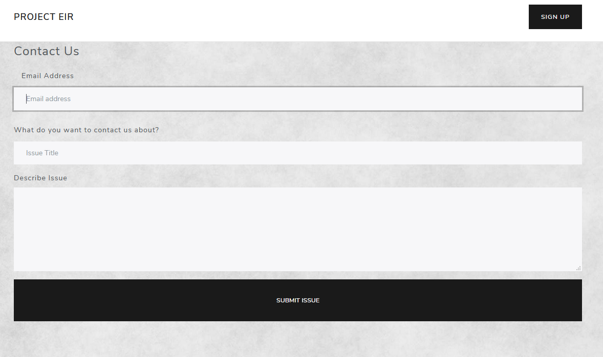
Customer Support - Ticket Form
To send in a support ticket the form to fill out should be simple and easy to understand
Keep the info the user has to fill in at a minimum
Once the user clicks submit a copy of what they filled out should be emailed to them

Slide 11
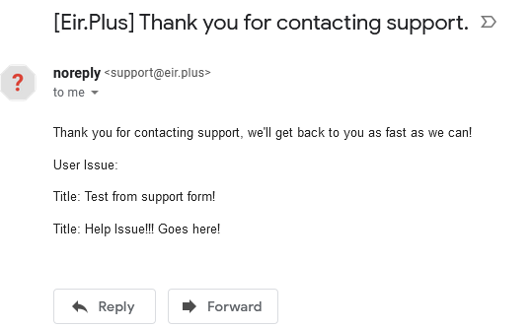
Customer Support - Ticket Form

Slide 12
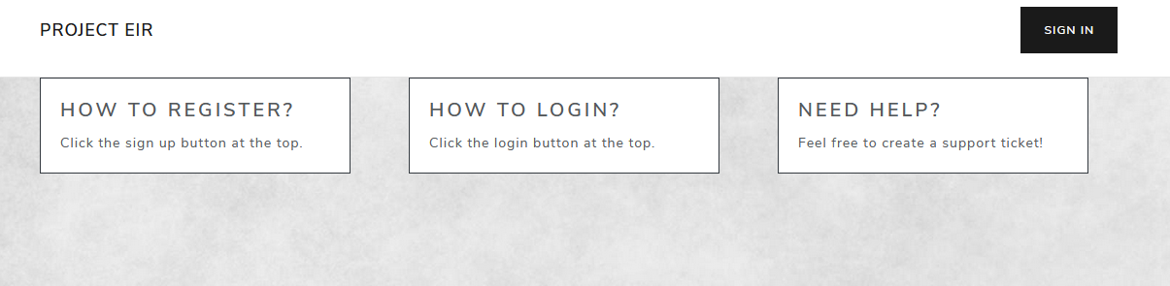
Customer Support - Frequently Asked Questions (FAQ)
FAQ should be read to understand
FAQ have questions that are asked the most

Slide 13
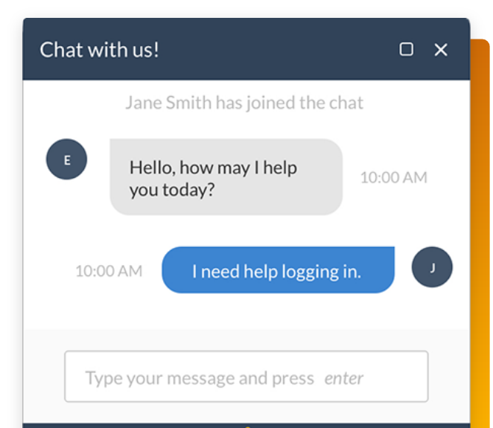
Customer Support - Future Add-ons
Other types of support functions could be added to the site like
Live Chat
Phone Number to call
And many others!

Slide 14
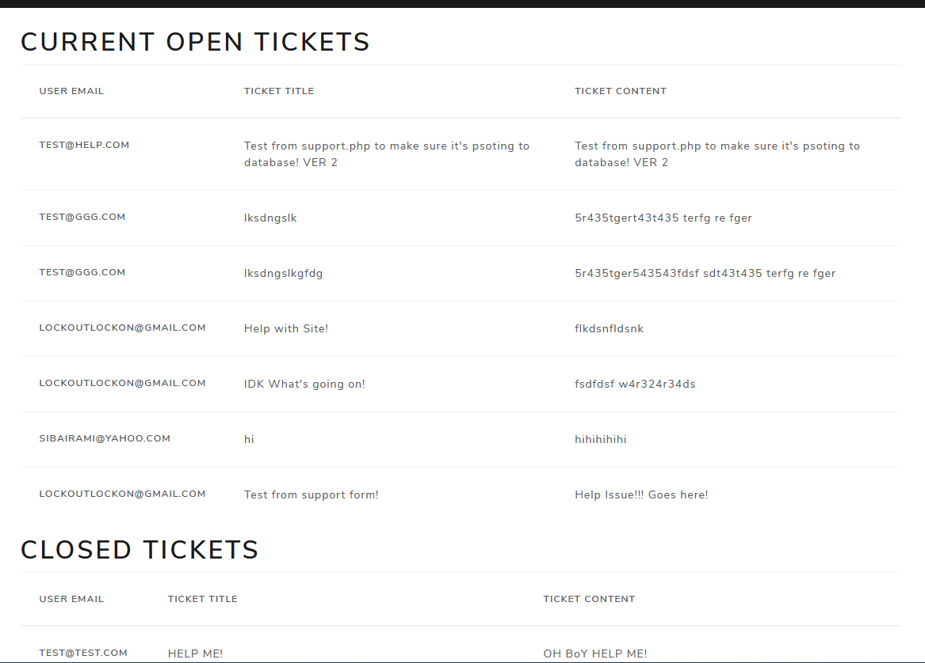
Admin Control
Basic Admin control page
Allows Admins/Support accounts to see open and closed support tickets
Easy to understand for Admins/Support personnel

Slide 15
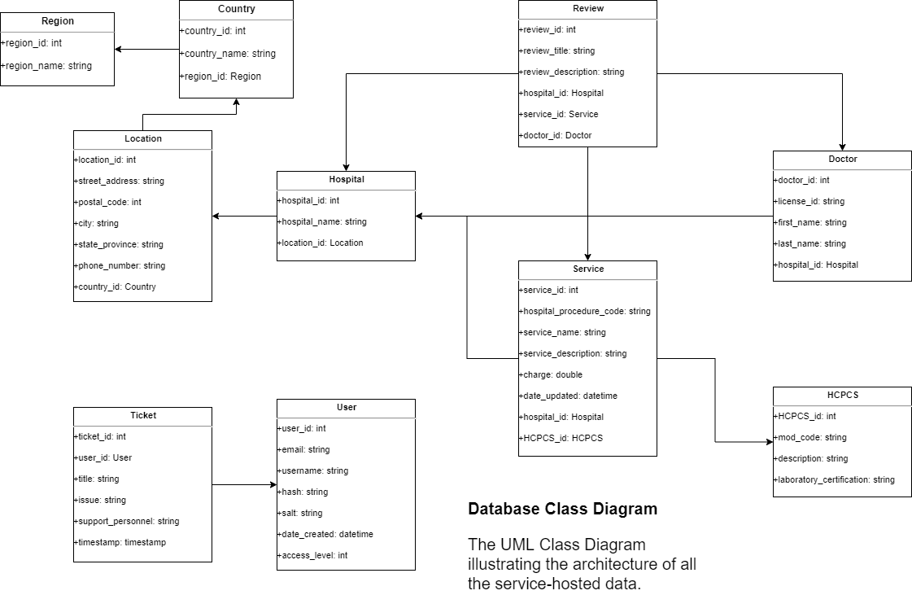

Slide 16
GDPR Compliance
GDPR (General Data Protection Regulation) is a regulation that addresses the transfer of personal data.
GDPR is the European Union counterpart to CCPA, discussed in the next slide.
GDPR compliance requires the following:
If Project Eir employs more than 10-15 employees, a Data Protection Officer must be appointed.
Documentation of data flow, data inventory, data collection. Keeping documentation on why data is being collected, how, and more importantly, how it is kept secure and how access is controlled.
Upon registration, include a Terms of Service agreement that obtains user consent to store and collect data. This data must have an expiration date, and there has to be a way for users to request the deletion of their data.
We have to perform regular auditing on our GDPR compliance.
Have a response ready for data breach, including notifying GDPR regulators.
Notes:
Source: https://gdpr.eu/compliance/

Slide 17
CCPA Compliance
CCPA (California Consumer Privacy Act) is a comprehensive regulation that enhances consumer privacy rights in the state of California.
CCPA compliance requires the following:
We must inform users of our intention of data collection before or at the point of collection. We can do this via an unobtrusive pop-up modal when users first register. This includes use in cookie tracking.
We must have a way to provide users with a comprehensive report on what personal information is being stored when they request for it. Has to be honored only twice per year per user.
Include separate page somewhere detailing our CCPA compliance.
Delete the user’s personal information upon request.
Notes:
Source: https://oag.ca.gov/privacy/ccpa

Slide 18
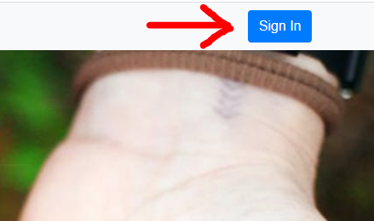
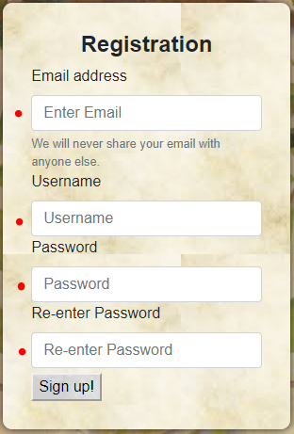
User Management
Making sure users can register and create an account
Returning members have the ability to sign-in
Personalized sessions when you log in
Error messages to alert the user if any fields were misfilled or left empty

Slide 19
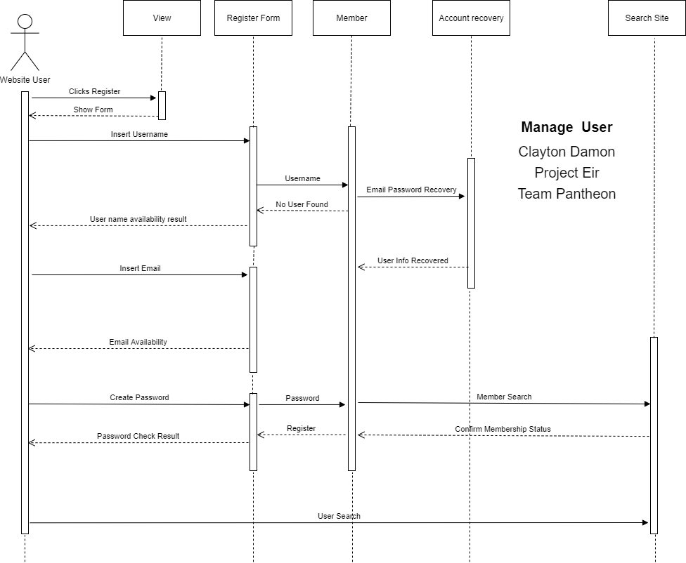
Sequence Diagram
Sequence diagram for User Management bucket
Helps show a visual representation of how the user interacts with our site
Email and Username availability
Password Match
Sign in

Slide 20
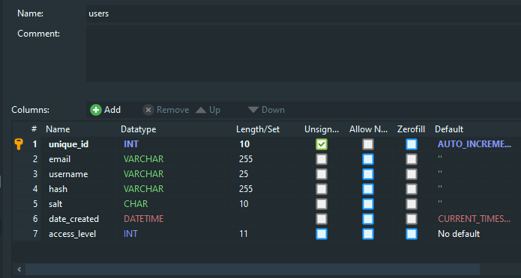
Dependencies
GUI
Worked with Rami, let him know what buttons I needed for the user
Let him know what I needed the registration/sign in forms to ask the user or returning members
Database
Worked with Leonardo to connect to the database
Store and protect user information

Slide 21
Conclusion
Future Plans:
Specific hospital searches
Price comparison
Doctor Reviews and Hospital Reviews
etc...

